Slide 1
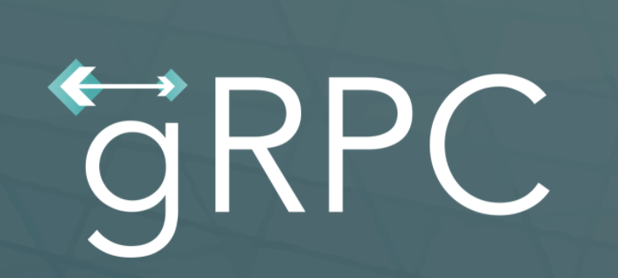


An introduction to

Slide 2



Who am I?
https://www.linkedin.com/in/marcelsamaruga/

Slide 3
Agenda
What is gRPC?
HTTP1.1 vs HTTP2
Protocol Buffers
gRPC APIs
gRPC vs Rest
Use Cases
gRPC Caveats

Slide 4
gRPC
Open source project developed by Google in 2015
RPC (Remote Procedure Call)
CNCF
HTTP/2
Protocol Buffers
Language agnostic

Slide 5
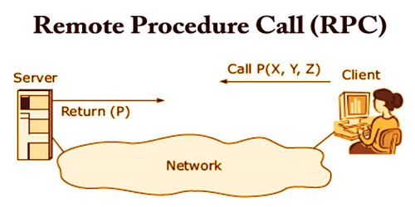
RPC

Slide 6
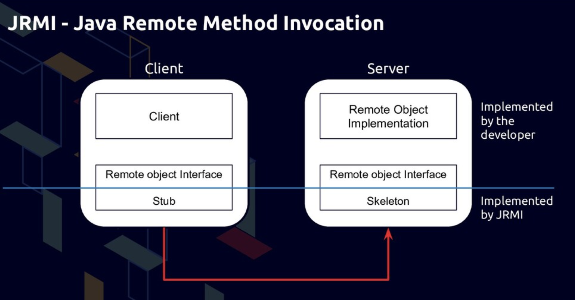
RMI

Slide 7
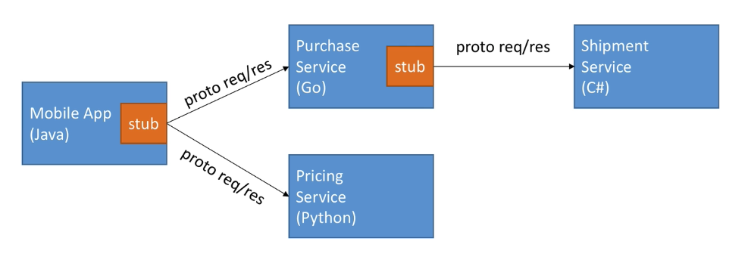
gRPC

Slide 8
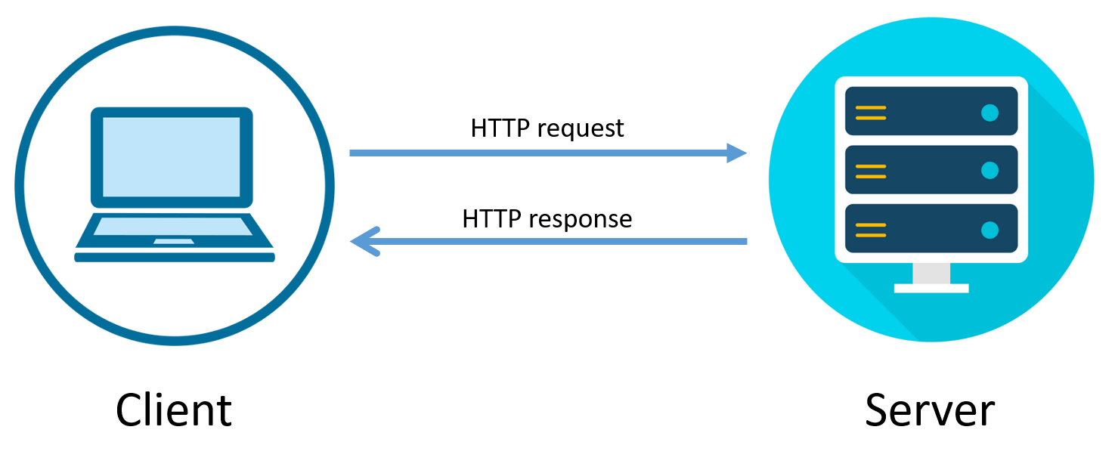
HTTP/1.1
Request <-> Response

Slide 9
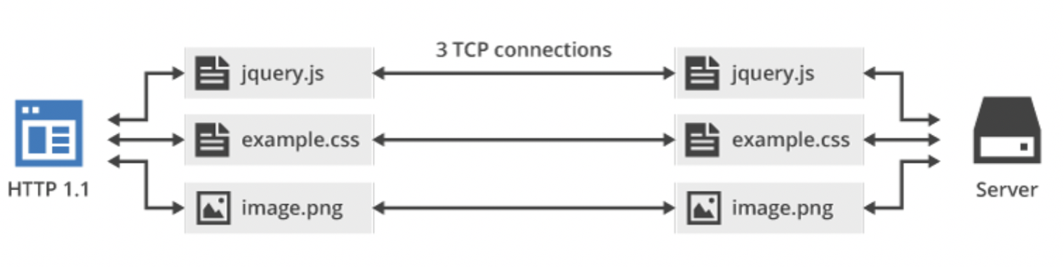
HTTP/1.1
Request <-> Response

Slide 10
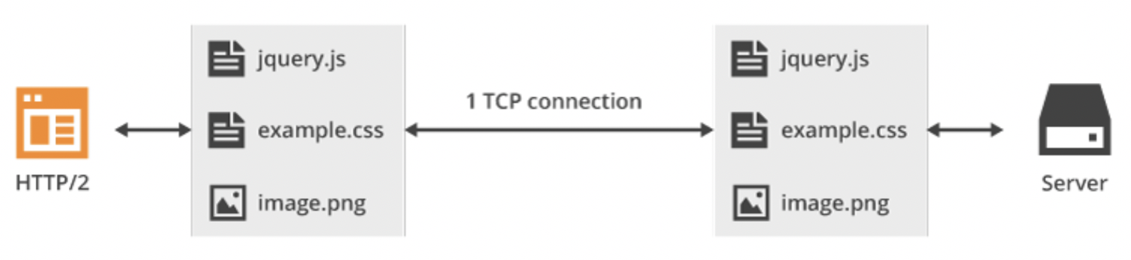
HTTP/2
1 TCP Connection – Multiplexing – Server Push

Slide 11
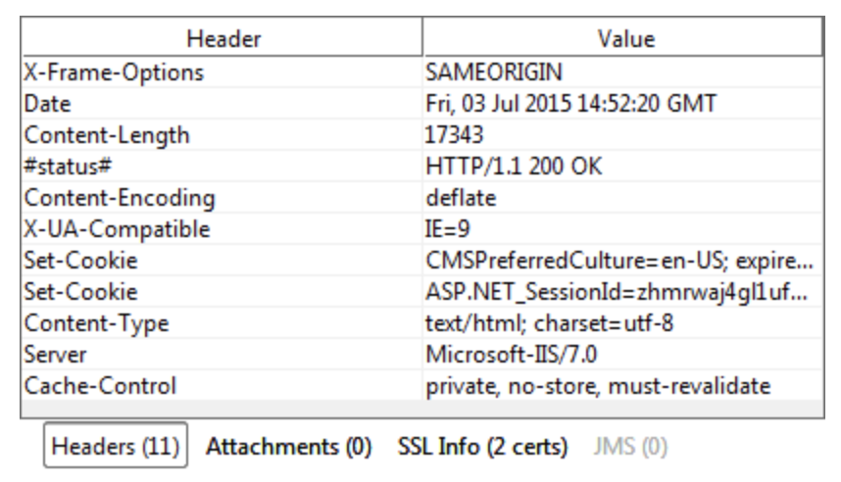
HTTP/1.1
HTTP Headers

Slide 12
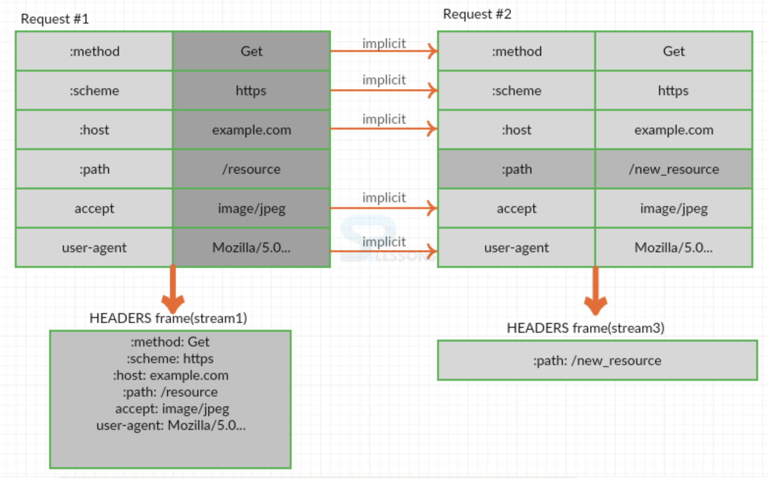
HTTP/2

Slide 13
HTTP/1.1

Slide 14
HTTP/2

Slide 15
HTTP/2 (Server Push)

Slide 16
HTTP/1.1 vs HTTP/2
https://imagekit.io/demo/http2-vs-http1?utm_source=blog&utm_medium=blog&utm_campaign=Blog

Slide 17
Protocol Buffers
Serialize/Deserialize structure data
IDL
Super fast communication
Provides client libraries automatically
Java
Go
C#
Javascript
Ruby
C++
Dart
Kotlin
Python
Objective C
PHP

Slide 18
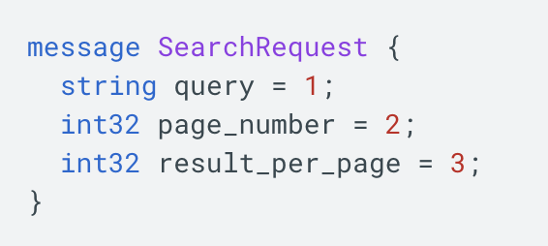
Protocol Buffers

Slide 19
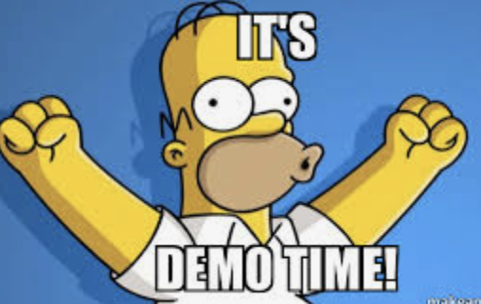
Protocol Buffers

Slide 20

Protocol Buffers (caution)
Default values
-> google/protobuf/wrappers.proto

Slide 21
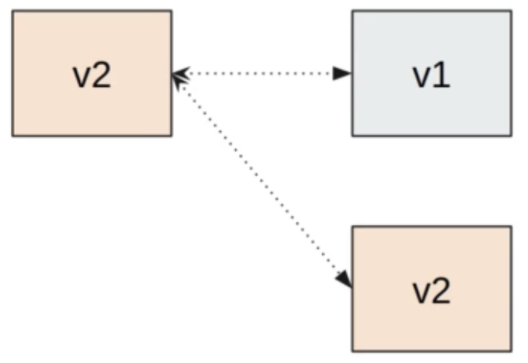
Protocol Buffers (caution)
Reusing indexes

Slide 22

Protobuf - Do
1-15 Frequently Fields
New fields
Reserved

Slide 23

Protobuf – Dont’s
Reorder fields
Warning: change types
Warning: rename fields

Slide 24
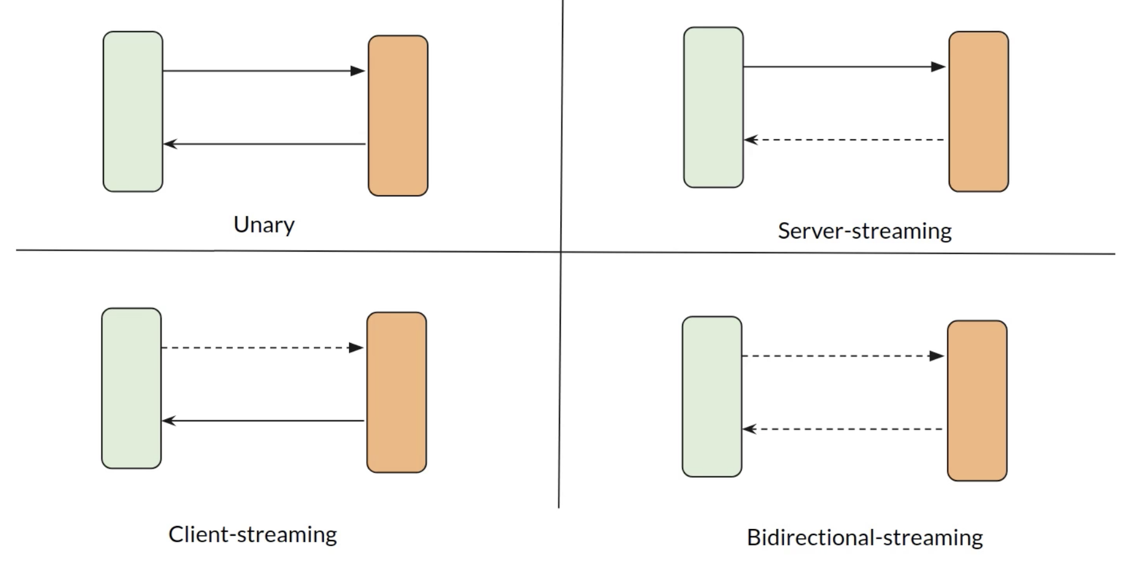
gRPC APIs

Slide 25
Protocol Buffers

Slide 26
gRPC vs REST
What is gRPC?
HTTP1.1 vs HTTP2
Protocol Buffers
gRPC vs Rest
gRPC Method Types
Use Cases
gRPC Caveats

